Slide 1

Ethics, Ethical Framework, Moral Behaviour

Slide 2
What is Ethics?
At its simplest, ethics is a system of moral principles. They affect how people make decisions and lead their lives.
Acceptable behaviour VS Unacceptable Behaviour
Rights VS Wrong
Obvious VS Debatable
Notes:
https://www.bbc.co.uk/ethics/introduction/intro_1.shtml

Slide 3
Meaning of Ethics:
The word Ethics is derived from the Greek word ‘ethos’ which means character or conduct. Ethics is also called moral philosophy or philosophical thinking about morality. This morality has been further elaborated as action and behaviour which is concerned with ‘good’ or ‘evil’, of particular traditions, groups or individual.
The term ‘moral’ and ‘ethical’ is often used as equivalent to right or good as opposed to ‘immoral’ and ‘unethical’. It doesn’t mean morally right or morally good but it definitely pertains to morality

Slide 4

Ethics
Ethics is a branch of philosophy that is primarily concerned with questions pertaining to the good life.
Ethics deals with moral principles, values, and judgments that guide human behaviour and actions in order to achieve a good and fulfilling life.
It explores concepts such as right and wrong, virtue, duty, and moral responsibility, providing a framework for individuals to make ethical decisions and live a morally upright life.

Slide 5
What influences our Choices?
Family & Childhood
Value system
Relationships
Common Sense.
Environment

Slide 6
Why We need to Ethical Behave:
Ethics guides you to tell the truth, keep up your promises or commitment.
To honest and Responsible
Build your confidence and self esteem
Develop ethical leadership skills.
Ethical leaders place importance on honesty, justice and well-being of others.
Decision-making in everyday life
Developing long-term character
Fostering civic engagement and social responsibility
Promote respect for the rights, feelings, perspective of others.

Slide 7
Professional Ethics
Key Features of Professional Ethics:
Integrity – Being honest and doing the right thing, even when no one is watching.
Accountability – Taking responsibility for your actions and decisions.
Confidentiality – Respecting and protecting private or sensitive information.
Competence – Continuously improving your skills and delivering quality work.
Respect – Treating clients, colleagues, and the public with dignity and fairness.
Objectivity – Making decisions based on facts, not personal feelings or bias.

Slide 8
Why Is Professional Ethics Important?
Builds trust between professionals and clients or society.
Ensures consistency and fairness in decision-making.
Prevents abuse of power, corruption, and misconduct.
Helps professionals navigate ethical dilemmas.
Maintains the reputation of a profession.

Slide 9
Examples by Profession:
Doctors: Do no harm, respect patient privacy, obtain informed consent.
Teachers: Be fair to all students, avoid favoritism, promote integrity.
Lawyers: Defend clients within the bounds of the law, avoid conflicts of interest.
Engineers: Ensure safety and sustainability, avoid negligence.
Researchers: Report data truthfully, give proper credit, avoid plagiarism.

Slide 10
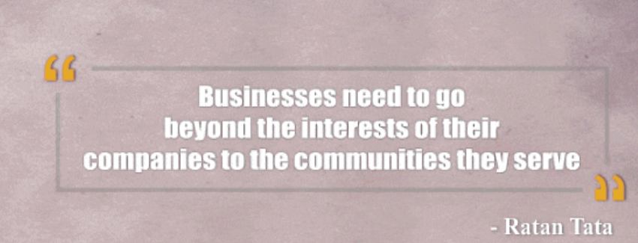
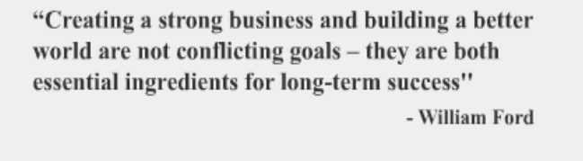
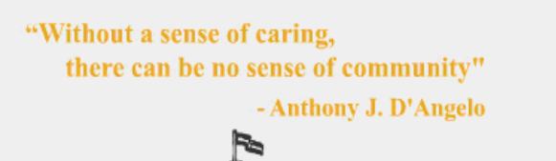
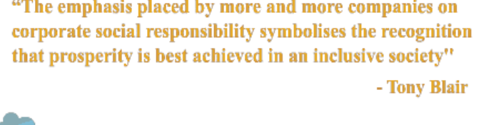
Famous Quotes on Business Ethics & Responsibilities

Slide 11
How does an ethical framework shape your moral behavior?
1. Academic Integrity
You find a copy of last year’s exam. Do you use it to cheat, or do you study it as a practice guide?”
On the last day of assignment submission, do you copy and submit his own work ?
Discussion: Highlight values like honesty, fairness, and respect for academic rules.
Plagiarism is wrong and cheating [Whether you copy or allowing others to copy]

Slide 12
2. Responsibility in Group Work
Example:
“In a group project, one member isn’t contributing. Do you cover for them or report honestly?”
In a group project, one member has contributed well, do you acknowledge?
Discussion: Encourages responsibility, transparency, and teamwork ethics.

Slide 13
3. Digital Ethics
“You’re part of a class WhatsApp group. Someone shares a private photo of a student.
Do you forward it, comment, or report it?”
🔍 Discussion: Teaches digital responsibility and privacy awareness.

Slide 14
4. Using Resources Honestly
Example:
“You find a friend’s assignment that scored well.
Do you copy parts of it for your submission?”
🔍 Discussion: Brings up plagiarism, respect for others’ work, and self-respect.

Slide 15
Challenges in applying ethical frameworks
Peer Pressure and Social Influence
Conflicts Between Personal and Social Ethics

Slide 16
SRM Institutional Code of Ethics
Read about the list of Ethical committees available in SRM
Institutional Ethics Committee (IEC)
Institutional Animal Ethics Committee (IAEC)
Institutional Bio Safety Committee (IBSC)
Chemical Waste Disposal Committee (CWDC)
Plagiarism Checks: SRM deploys a software Turnitin Anti Plagiarism Tool to deduct Students work
Pls see the pdf for more details

